Slide 2
Did you finish your homework?
Of course!

Slide 4
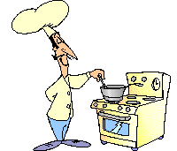

Slide 5
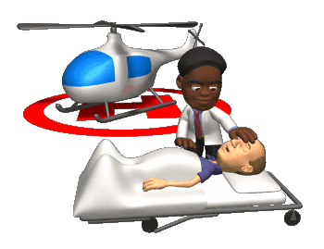
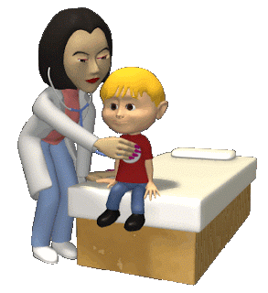

Slide 6
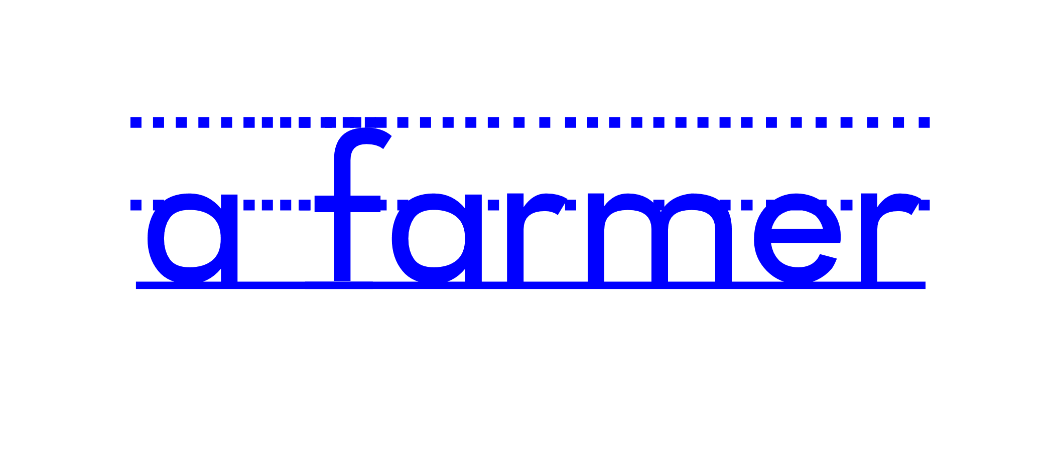

Slide 7
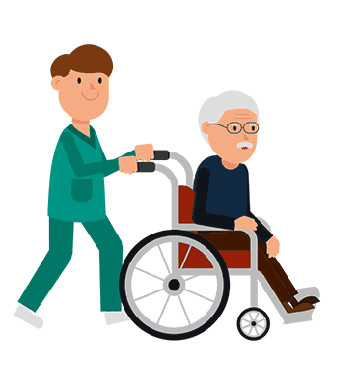

Slide 8
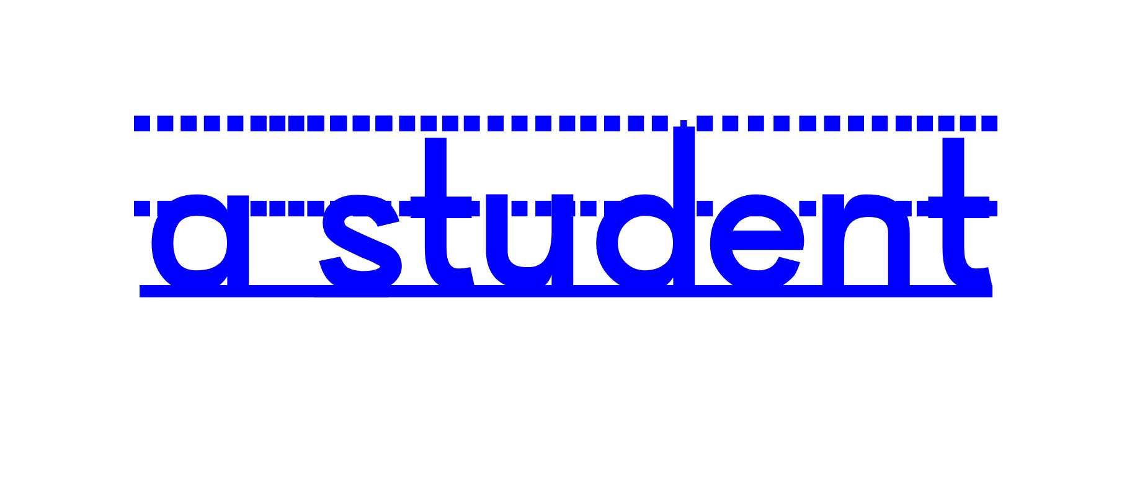

Slide 9
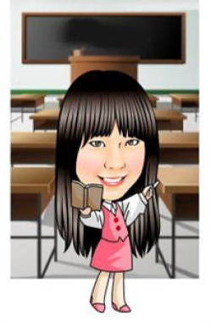

Slide 10
a teacher
a cook
1
2
3
a student
4
5
6
a doctor
a nurse
a farmer

Slide 11
a teacher
a cook
1
2
3
a student
7
Boom!
4
5
6
a doctor
a nurse
a farmer

Slide 13
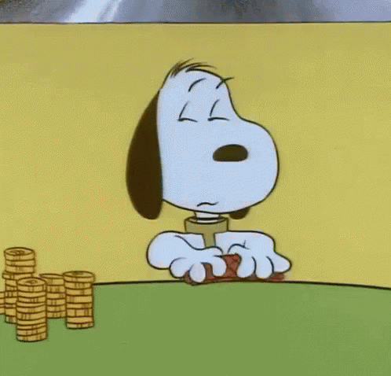
Let’s play the card games!
Role call
(Who is a _____?
I’m a ______.)
2. Matching

